Slide 1
FC300 v FC200 Comparison
March 2013

Slide 2
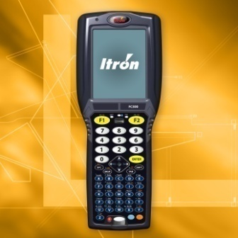
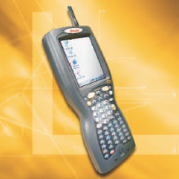
Comparison of The FC300 and The FC200

Slide 3
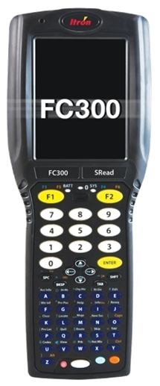
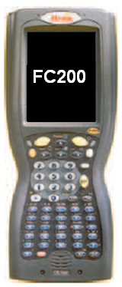
Basic Handheld Differences
FC300 | Feature | FC200
Windows CE 5.0 | Operating System | Windows CE 4.2
806 MHz | Processor | 400 MHz
Standard | Bluetooth | Optional
Optional | 802.11 WLAN | Optional
Standard | Vibration Feedback | Not Available
Standard | Rubber Overmold | Not Available
Standard | Integrated Flashlight | Not Available
Integrated or BT | GPS Receiver | Bluetooth Only
Integrated or BT | Scanner/Imager | Bluetooth Only
Automatic by Windows CE 5.0 | System Backup | Manual by iRescue

Slide 4
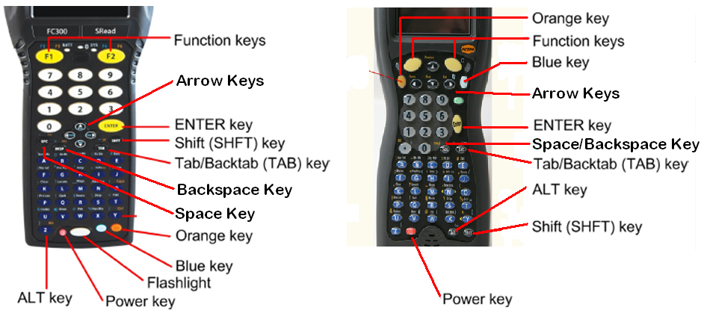
Basic Keyboard Differences

Slide 5
Keyboard Operational Differences
FC300 | Feature | FC200
Blue + Key | Special Characters | Orange + Key
Blue + V + Up Arrow + Enter | Volume Up | Blue + V + Up Arrow + Enter
Blue + V + Down Arrow + Enter | Volume Down | Blue + V + Down Arrow + Enter
Blue + B + Up Arrow | Brightness Up | Orange + 7
Blue + B + Down Arrow | Brightness Down | Orange + O (Oh)
Orange + Z + F1 | Soft Boot | Hold down Orange + Power (Red) For x seconds
Hold down Power key for 15 seconds. Press Power to resume. | Hard Boot | Hold down Orange + Blue + Power (Red) For x seconds

Slide 6
Keyboard LED Differences
FC300 | LED | FC200
Off – No External Power Red – Charging Green – Charged Yellow – Standby Blinking Red – Battery Fault | BATT / LEFT LED | Off – No External Power Blinking Green – Charging Green – Charged Double Blink Green – Fault
Solid Red – Battery Low Blinking Red – Power Failure Blinking Green – System Idle Yellow/Amber – Resuming | SYS / RIGHT LED | Alternating Red/Green Blink – iRescue Backup in Process Red, Green or Amber – Writing Data to Disk

Slide 7
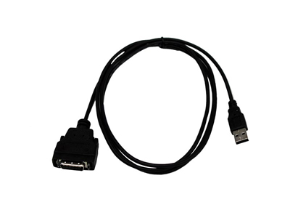
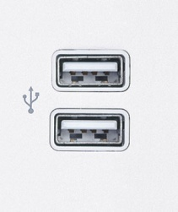
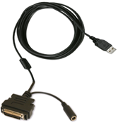
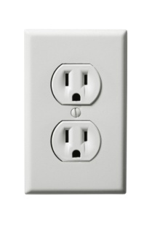
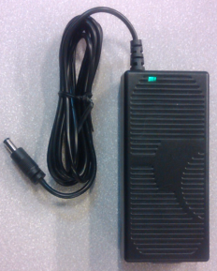
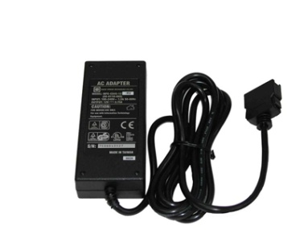
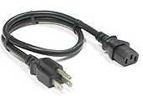
Handheld Cable Differences
FC300 | Feature | FC200
Direct USB Y-Cable | USB | Direct USB Cable
Via the USB Y-Cable | Power | Direct Power Cable
* The FC300 and FC200 cannot use the same power supplies.
* The power supplies for each handheld can be used to power the handheld directly as well as to power the desk dock for each handheld.

Slide 8
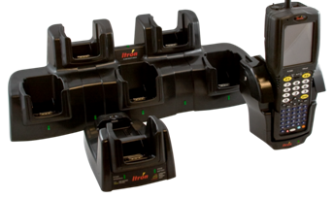
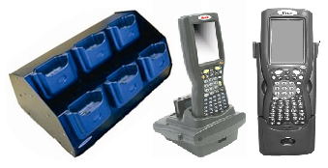
Basic Dock Differences
While the FC300 and FC200 have similar names, the body and connectors on the handhelds are different and thus cannot use the same docks.
FC300 | Dock | FC200
Five Handhelds | Multi-dock | Six Handhelds
Standard | Desk Dock IP Comm | Optional
One Handed Removal | Vehicle Dock | Two Handed Removal

Slide 9
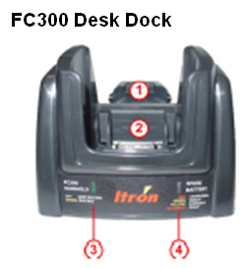
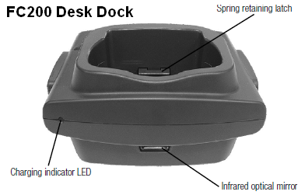
Desk Dock Operation Differences
FC300 | Dock | FC200
Green – Docked | Handheld LED | N/A
Red – Charging Green – Ready Yellow – Standby Flashing – Fault | Spare Battery LED | Green – Ready Blinking Green – Charging Double Blink Green – Fault Amber – Calibration Discharge Blinking Amber – Cal. Charge

